Slide 1
Building Movie Review Website III
Week 12.

Slide 2
Objectives
Demonstrate how to build the basic architecture of a web application based on a Movie Review website;
Demonstrate how to build the web pages of a Movie Review website.

Slide 3
Tools Required
Visual Studio Code
Node.js
Browser
Google Chrome (recommended)
Mozilla Firefox

Slide 4
Creating the View…Continue

Slide 5
Creating Add New Comment Modal Window
Watch the demo here
We will now create the New Comment Modal Window.
Let’s look at the wireframe for this in the next slide.

Slide 6
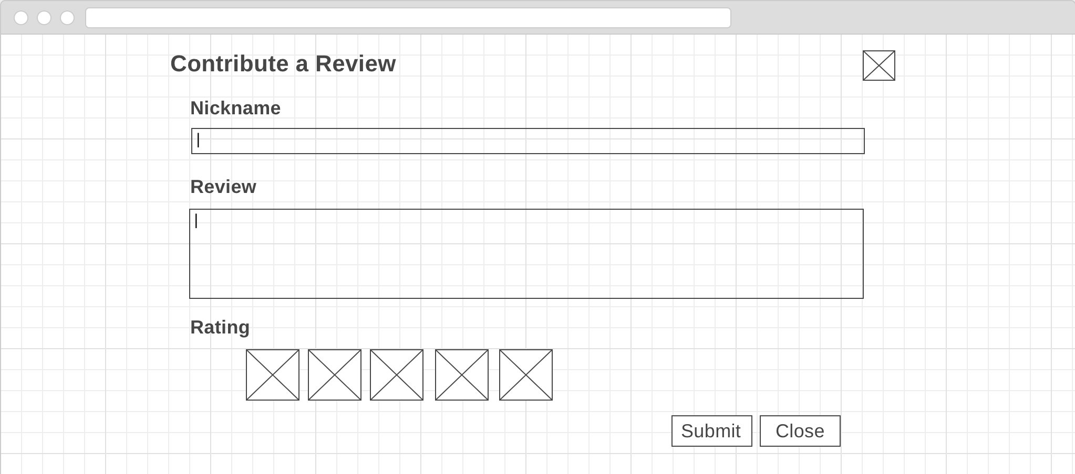
Wireframe – Add/Update Comment
Text input for username or nickname of user giving the comments. If editing an existing comment, this will show the original nickname.
Image icon to close modal window when clicked.
Text input of comments. If editing an existing comment, this will show the original comment.
Five image icons of popcorns. Default colour is black-and-white. When mouse hover each of them, it will turn to colour.
Button to close modal window when clicked.
Button to submit all inputs to server when clicked.
Notes:
https://wireframe.cc/mF3Mql

Slide 7
Creating Add New Comment Modal Window - new-comments-modal.html
<div class="modal fade" id="newCommentModal" tabindex="-1" role="dialog">
<div class="modal-dialog modal-lg" role="document">
<div class="modal-content">
<div class="modal-header bg-dark text-center">
<h3 class="modal-title text-light">Contribute a Review</h3>
<button type="button" class="close bg-light" data-dismiss="modal">
<span>&times;</span>
</button>
</div>
<div class="modal-body px-5">
<!-- All input to be sent to server, and buttons must be within the 'form' tag -->
<form id="commentForm">
<div class="row" text-center id="commentBody">
<label for="nickname">Nickname</label>
<input type="text" id="nickname" class="form-control" required>
<label for="userComments">Review</label>
<textarea id="userComments" required class="form-control form-rounded" rows="3" cols="100%"></textarea>
<label for="popcorn">Rating</label>
<img src="images/popcorn_bw.png" class="pop" value="1" onmouseover="rateIt(this)" />
<img src="images/popcorn_bw.png" class="pop" value="2" onmouseover="rateIt(this)" />
<img src="images/popcorn_bw.png" class="pop" value="3" onmouseover="rateIt(this)" />
<img src="images/popcorn_bw.png" class="pop" value="4" onmouseover="rateIt(this)" />
<img src="images/popcorn_bw.png" class="pop" value="5" onmouseover="rateIt(this)" />
</div>
<div class="modal-footer">
<button type="button" class="btn btn-primary" data-dismiss="modal" id="submitComment" onClick="addComment()">Submit</button>
<button type="button" class="btn btn-secondary bg-dark" data-dismiss="modal">Close</button>
</div>
</form>
</div>
</div>
</div>
</div>

Slide 8
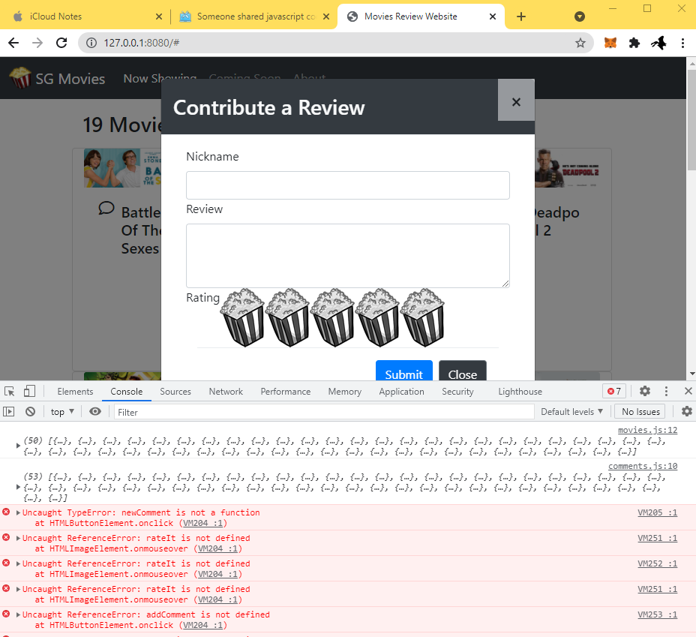
Test the Add New Comments Modal Window
Test the new Comment Modal and it should pop up but with some javascript errors as the js engine was not able to find those functions

Slide 9
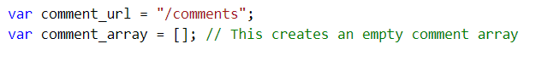
Creating Add New Comment Modal Window
Under your js folder, open the app.js file and create two new variables for the popcorn images, and another for rating as highlighted below.
var popcornBWImage = 'images/popcorn_bw.png';
var popcornImage = 'images/popcorn.png';
var rating = 0;

Slide 10
Creating Add New Comment Modal Window - comments.js
function newComment() {
//Initialise each HTML input elements in the modal window with default value.
rating = 0;
document.getElementById("userComments").value = "";
document.getElementById("nickname").value = "";
}
The purpose of this function is to clear out any (old) existing comments that had been written by the user.

Slide 11
Creating Add New Comment Modal Window - comments.js
// Submit or send the new comment to the server to be added.
function addComment() {
var comment = new Object();
comment.movieId = movie_array[currentIndex]._id; // Movie ID is required by server to create new comment
comment.movie = movie_array[currentIndex].title; // Movie title is required by server to create new comment
comment.username = document.getElementById("nickname").value; // Value from HTML input text
comment.review = document.getElementById("userComments").value; // Value from HTML input text
comment.datePosted = null; // Change the datePosted to null instead of taking the timestamp on the client side;
comment.rating = rating;
var postComment = new XMLHttpRequest(); // new HttpRequest instance to send comment
postComment.open("POST", comment_url, true); //Use the HTTP POST method to send data to server
postComment.setRequestHeader("Content-Type", "application/json");
postComment.onload = function() {
console.log("new comment sent");
fetchComments(); // fetch all comments again so that the web page can have updated comments.
};
// Convert the data in Comment object to JSON format before sending to the server.
postComment.send(JSON.stringify(comment));
}

Slide 12
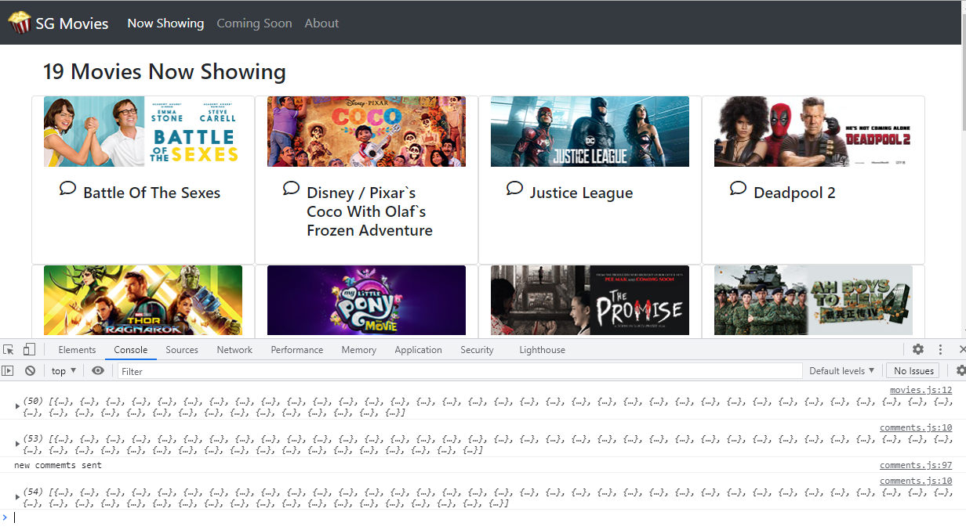
Test the Add New Comments Modal Window
Test the codes that were added and you should see the console message. Check mysql workbench or postman to verify that one new comment had indeed been inserted. However the rating value is always zero. We will work on this in the next slide

Slide 13
Creating Add New Comment Modal Window - comments.js
//This function allows the user to mouse hover the black and white popcorn
//so that it will turn to a colored version when hovered
function rateIt(element) {
var num = element.getAttribute("value");
var classname = element.getAttribute("class");
var popcorns = document.getElementsByClassName(classname);
var classTarget = "." + classname;
// This is another way of writing 'for' loop, which initialises the
// popcorn images to use black and white.
for (let popcorn of popcorns){
popcorn.setAttribute("src", popcornBWImage);
}
changePopcornImage(num, classTarget);
}
// This function sets the rating and coloured images based on the value of the image tag when
// the mouse cursor hovers over the popcorn image.
function changePopcornImage(num, classTarget) {
switch (eval(num)) {
case 1:
document.querySelector(classTarget + "[value='1']").setAttribute("src", popcornImage);
rating = 1;
break;
case 2:
document.querySelector(classTarget + "[value='1']").setAttribute("src", popcornImage);
document.querySelector(classTarget + "[value='2']").setAttribute("src", popcornImage);
rating = 2;
break;
case 3:
document.querySelector(classTarget + "[value='1']").setAttribute("src", popcornImage);
document.querySelector(classTarget + "[value='2']").setAttribute("src", popcornImage);
document.querySelector(classTarget + "[value='3']").setAttribute("src", popcornImage);
rating = 3;
break;
case 4:
document.querySelector(classTarget + "[value='1']").setAttribute("src", popcornImage);
document.querySelector(classTarget + "[value='2']").setAttribute("src", popcornImage);
document.querySelector(classTarget + "[value='3']").setAttribute("src", popcornImage);
document.querySelector(classTarget + "[value='4']").setAttribute("src", popcornImage);
rating = 4;
break;
case 5:
document.querySelector(classTarget + "[value='1']").setAttribute("src", popcornImage);
document.querySelector(classTarget + "[value='2']").setAttribute("src", popcornImage);
document.querySelector(classTarget + "[value='3']").setAttribute("src", popcornImage);
document.querySelector(classTarget + "[value='4']").setAttribute("src", popcornImage);
document.querySelector(classTarget + "[value='5']").setAttribute("src", popcornImage);
rating = 5;
break;
}
}

Slide 14
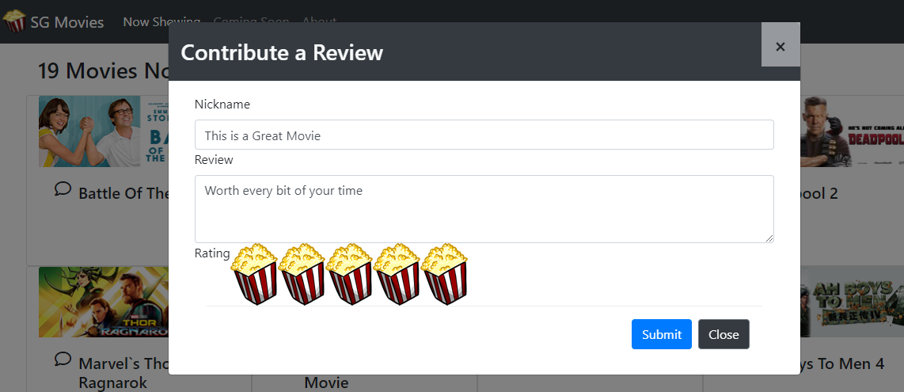
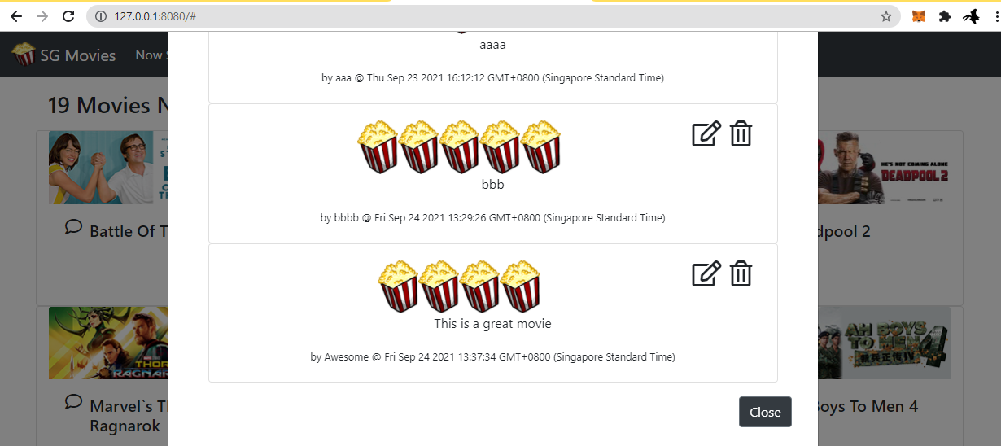
Test the Add New Comments Modal Window
Reload the index.html page and select a movie to create a new comment. After submitting the comment, wait a while and then click on the movie comments again to see if your submitted comment appears.

Slide 15
Next Episode…
In the next episode, we will build the modal windows to edit and delete comments.

Slide 16
The End

